Slide 1




eTwinning
A Professional Network for European Teachers

Slide 2

What’s eTwinning exactly?
An action within the Erasmus+ program (European Commission) that helps teachers from 32+ countries to connect and run collaborative distance-learning projects.
AND
A network of motivated, innovative teachers from all subject areas, languages, from pre-school to upper-secondary

Slide 3


A European action
Launched en 2005 as pilot
2007-2014 : integrated into
Lifelong Learning Program, Comenius
2014-2020 : part of Erasmus+

Slide 4
Organization of eTwinning
European platform managed by Central Support Service (CSS) in Brussels. European Schoolnet.
Every Erasmus+ country has an eTwinning National Support Service (NSS). British Council in UK, CANOPE in France, …
Regional network of support in many countries
eTwinning « ambassadors » in every country

Slide 5
It’s also
265 000+ registered teachers in Europe, 35 000+ active projects
32 countries from the Erasmus+ program (2014-2020), more to come
+6 neighbor countries through eTwinning Plus
Social network for teachers
Partner finding tools, networking tools
Secure workspace for projects (TwinSpace)

Slide 6
eTwinning seeks to develop …
Innovative teaching
Cross-cultural exchanges
European Citizenship
Language skills
Effective use of ICT
Best-practice sharing
Professional development for teachers

Slide 7

European Portal www.etwinning.net

Slide 8
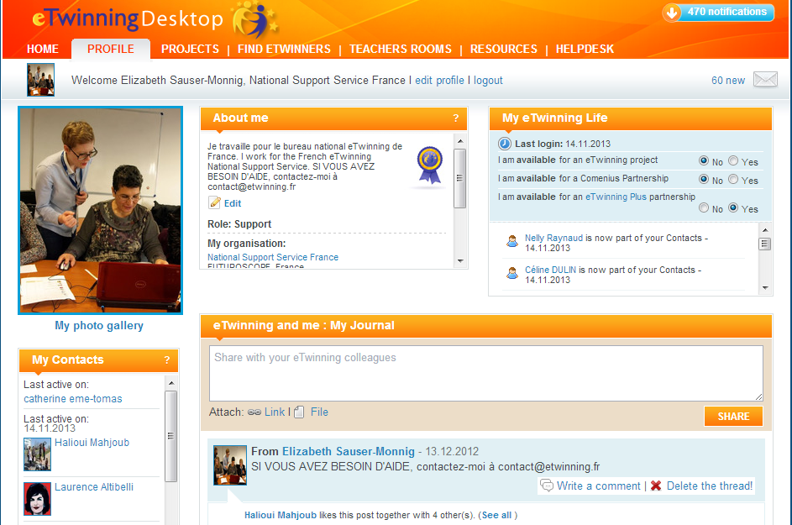
Professional social network for teachers

Slide 9
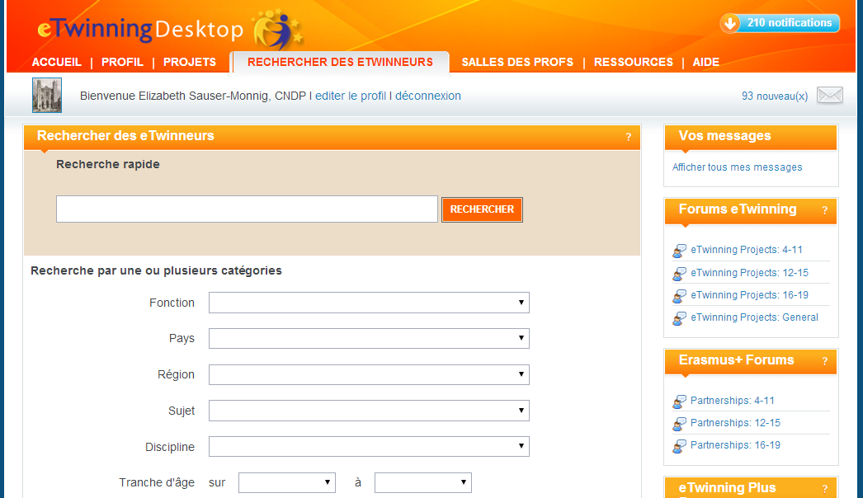
Tools to find project partners

Slide 10
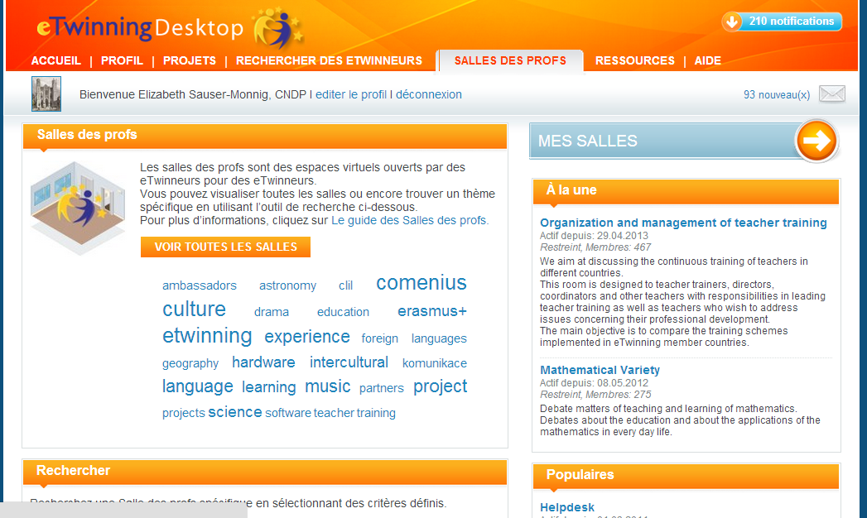
« Teachers’ Rooms » to engage with other teachers

Slide 11
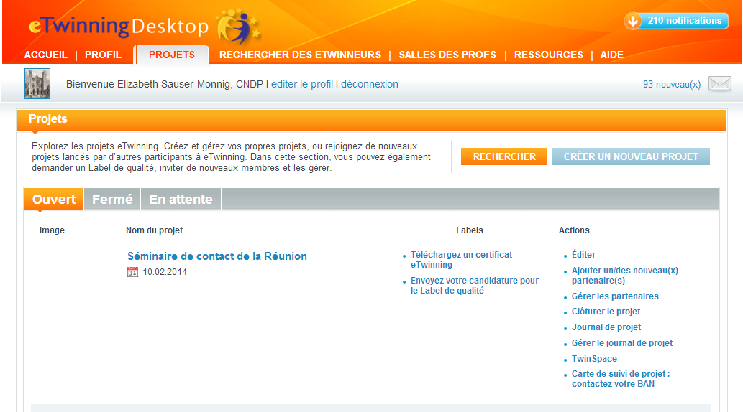
Register Your Project

Slide 12
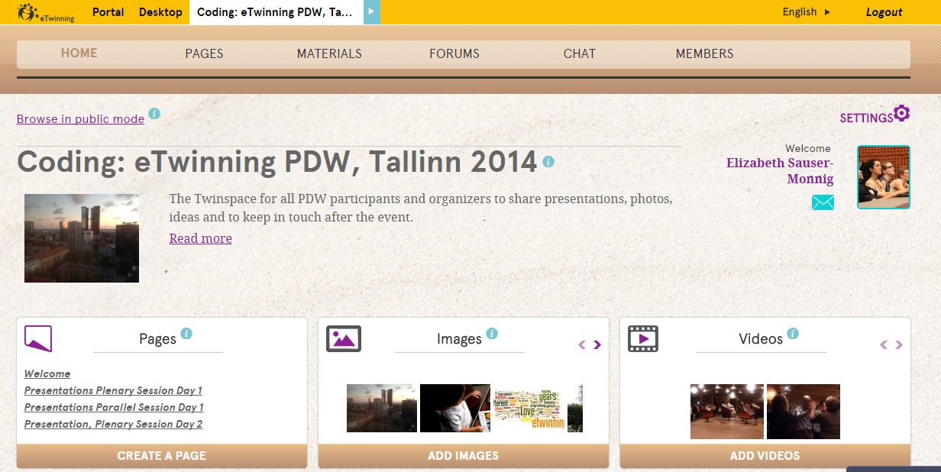
The Twinspace : a secure collaborative platform for projects

Slide 13
How can eTwinning help teachers?
Using project-based pedagogy and ICT tools:
Change teaching habits, classroom dynamics
Integrate ICT naturally
Use language as a communication tool
Open classroom up to Europe
Interdisciplinary and cross-curricular teaching… open your classroom up to the rest of the school !

Slide 14

eTwinning projects help pupils…
Be engaged, feel empowered
Develop autonomy and planning skills
Use language in real situations
Build ICT skills
Be more aware of life in other parts of Europe
Make connections between subjects areas

Slide 15
Professional Development in eTwinning
Formal and informal learning around pedagogy, ICT through…
Projects: on your own, from partners and pupils
Exchanges with other eTwinners
Face-to-face national workshops
European seminars
Online training: webinars, online courses

Slide 16

Best Practices and Recognition
Quality Labels (good for you and us!)
Ambassador network of eTwinners
National and European Prize Competitions
Dissemination of projects: eTwinning websites, social networks, school websites…

Slide 17
You are NOT alone! Call on the eTwinning support network
Your National Support Service (NSS)
Local support: eTwinning ambassadors, other regional representatives …
Central Support Service (Brussels)
Check out your national website for resources in your country

