Slide 1
General presentation eTwinning
French national support service
March 2017

Slide 2
What’s eTwinning exactly?
An action within the Erasmus+ program (European Commission) that helps teachers from 36 + countries to connect and run collaborative distance-learning projects.
A network of motivated, innovative teachers from all subject areas, languages, from pre-school to upper-secondary

Slide 3
An European action
Launched in 2005 as a pilot project
2007-2014 : integrated into Lifelong Learning Program, Comenius
2014-2020 : part of Erasmus+

Slide 4
Organization of eTwinning
European platform managed by Central Support Service (CSS) in Brussels. European Schoolnet.
Every Erasmus+ country has an eTwinning National Support Service (NSS). British Council in UK, CANOPE in France, …
Regional network of support in many countries
eTwinning « ambassadors » in every country

Slide 5
It’s also
460 000 registered teachers in Europe, 58 000 active projects
36 countries from the Erasmus+ program (2014-2020)
6 neighbours countries through eTwinning Plus
Social network for teachers
Partner finding tools, networking tools
Secure workspace for projects (TwinSpace)

Slide 6
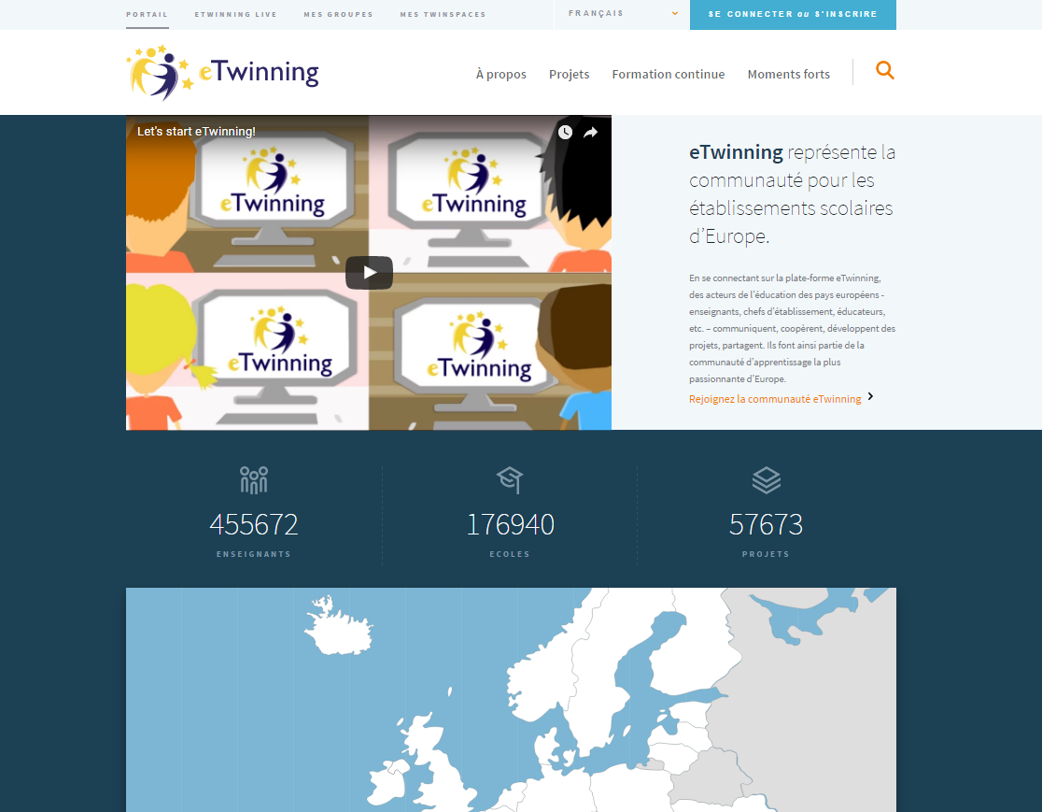
European Portal www.etwinning.net

Slide 7
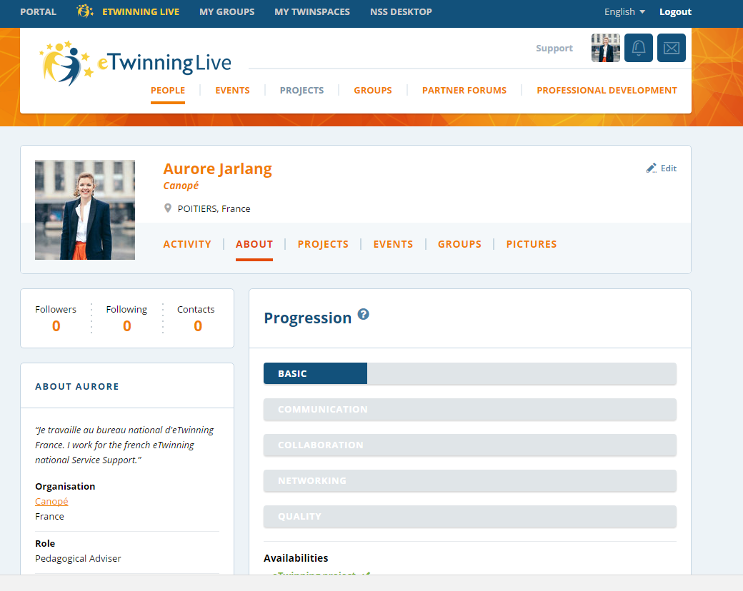
Professional social network for teachers

Slide 8
Tools to find partners

Slide 9
Create your project

Slide 10
The Twinspace : a secure collaborative platform for projects

Slide 11
How can eTwinning help teachers?
Using project-based pedagogy and ICT tools:
Change teaching habits, classroom dynamics
Integrate ICT naturally
Use language as a communication tool
Open classroom up to Europe
Interdisciplinary and cross-curricular teaching… open your classroom up to the rest of the school !

Slide 12
eTwinning projects help pupils…
Be engaged, feel empowered
Develop autonomy and planning skills
Use language in real situations
Build ICT skills
Be more aware of life in other parts of Europe
Make connections between subjects areas

Slide 13
Professional Development in eTwinning
Formal and informal learning around pedagogy, ICT through…
Projects: on your own, from partners and pupils
Exchanges with other eTwinners
Face-to-face national workshops
European seminars
Online training: webinars, online courses

Slide 14
Best Practices and Recognition
Quality Labels (good for you and us!)
Ambassador network of eTwinners
National and European Prize Competitions
Dissemination of projects: eTwinning websites, social networks, school websites…

Slide 15
You are NOT alone! Call on the eTwinning support network
Your National Support Service (NSS)
Local support: eTwinning ambassadors, other regional representatives …
Central Support Service (Brussels)
Check out your national website for resources in your country

