Slide 1
Introduction to eTwinning

Slide 2
eTwinning in numbers and words

Slide 3
2005
2014
2022
All subjects
From pre-primary school to upper secondary school
+ 140 000 projects

Slide 4
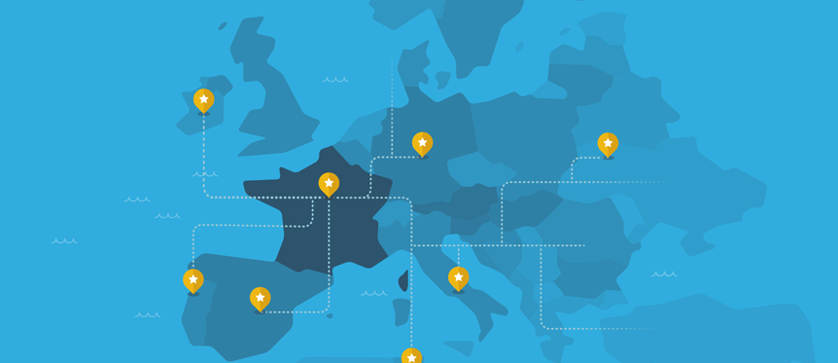
L’organisation d’eTwinning
The EU platform is managed by the Central Support Organisation in Brussels (CSS), European Schoolnet.
Each eTwinning country has its own National Support Organisation (NSO)
In most countries, there is a regional network
In each country, a network of eTwinning ambassadors – experienced teachers in eTwinning

Slide 5
Who is part of eTwinning ?
44 countries
33 Erasmus+ countries
+
11 countries :
Albani, Bosnia-Herzegovina
Armenia, Azerbaijan, Georgia, Jordan, Lebanon, Moldova, Montenegro, Tunisia, Ukraine

Slide 6
Répartition par niveaux scolaires

Slide 7
Visibility in the institutional and media spheres
Presence of the Minister of Education at the national competition prize-giving ceremony in 2022
Contribution to a DGESCO guide to teaching modern languages (Chantal Manes and Alex Taylor) : « Propositions pour une meilleure maîtrise des langues vivantes étrangères. Oser dire le nouveau monde »
Frequent presentations at the IH2EF (Higher Institute in Education and Training for school leaders) : initial training for headteachers and 1st and 2nd level inspectors
Letters to “Recteurs d’académie” to inform them of teachers who have obtained the Quality Label in their academy
eTwinning section of the DGESCO website, EduScol
Listing of eTwinning projects in EduBase
Projects publications in Educ@vox and the Café Pédagogique (teachers interviews)

Slide 8
National / European priorities :
Develop eTwinning in vocational training, in rural or remote areas
Develop eTwinning in Pre-primary and primary schools, in non-linguistic subjects
Train/target more multipliers: headteachers, educational advisors, inspectors, etc.
Seminar for educational advisers, National training of school inspectors
Presentations at the IH2EF (Higher Institute in Education and Training for school leaders)
Encourage and develop a school-wide approach (eTwinning School) : eTwinning School FR seminar
European Thematic Conference for Managers
The annual thematic year

Slide 9
eTwinning et Erasmus+
The Erasmus + France / Education Formation Agency = main operator of the actions of the Erasmus+ programme
Agreement between Réseau Canopé and the Erasmus + France / Education Formation Agency
Joint presentations at the IH2EF for school leaders in training
Participation in our respective events: national and European eTwinning conferences,
Erasmus+ seminar, Erasmus+ seminar for apprentices
Publication: "Développer l'ouverture européenne internationale dans son établissement scolaire" https://www.etwinning.fr/decouvrir/etwinning-dans-erasmus.html

Slide 10
eTwinning & Erasmus+ in a video
Click on the picture to watch the video

Slide 11
Three online spaces

Slide 12
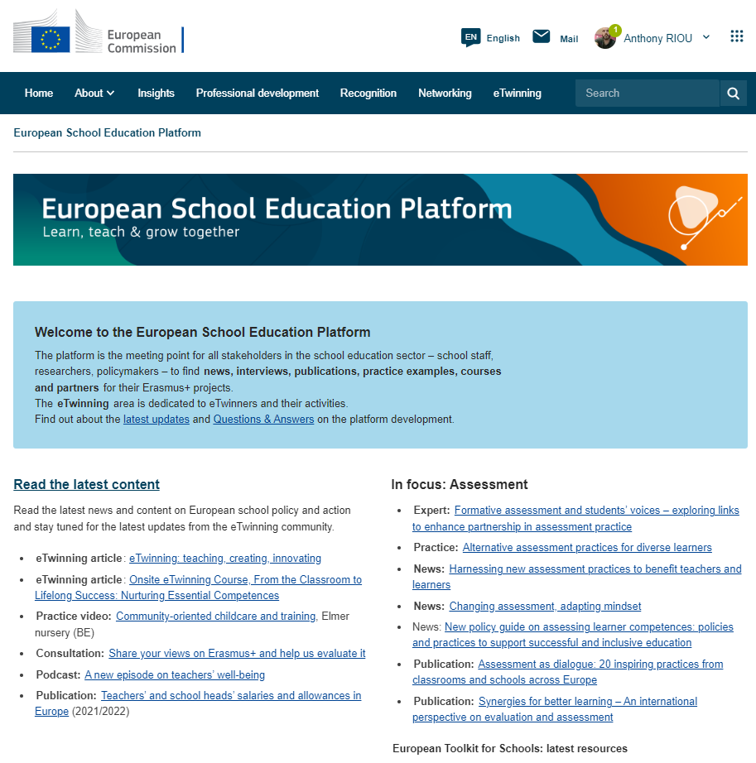
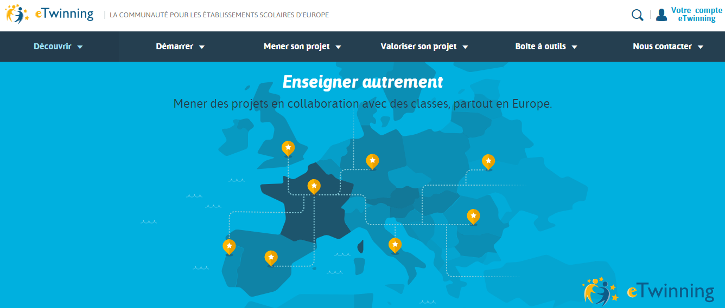
1. European and national portal
The European School Education Platform (ESEP) https://school-education.ec.europa.eu/fr
https://www.etwinning.fr/

Slide 13
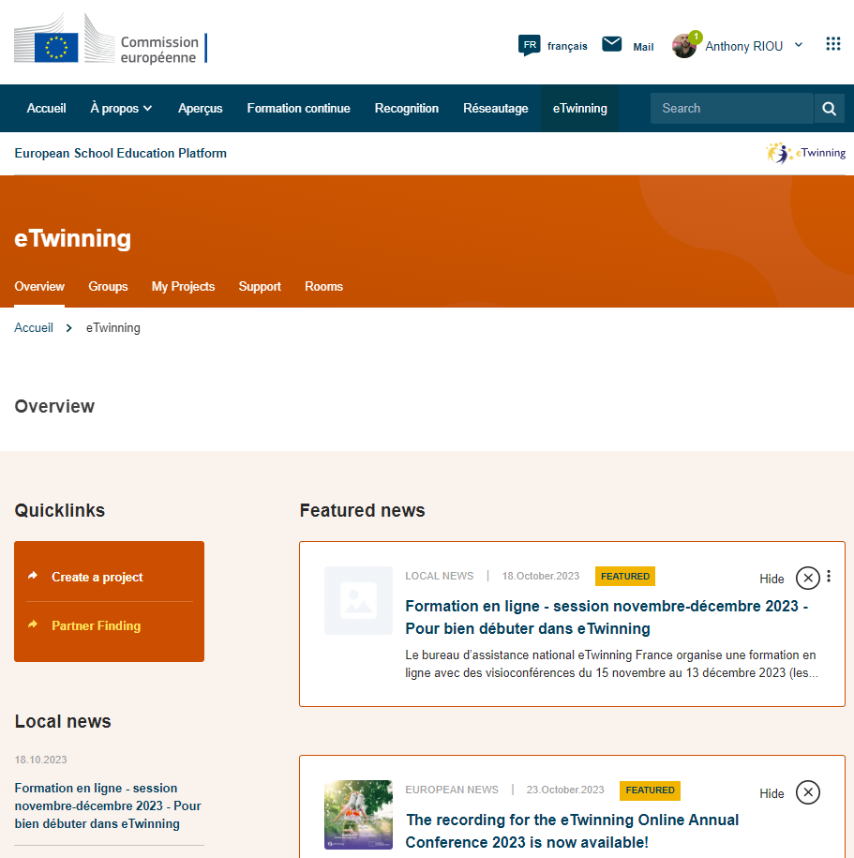
2. The « eTwinning » section

Slide 14
3. The secure online workspace :
the TwinSpace

Slide 15
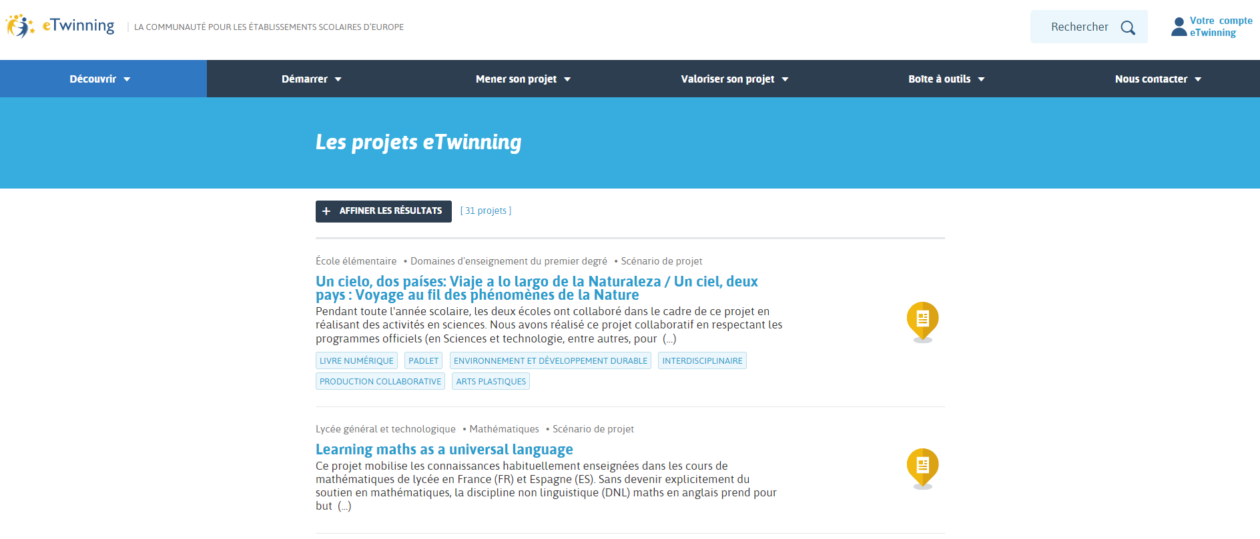
What is an eTwinning project ?
Click on the picture to get access to projects and activities examples (in French)

Slide 16
Focus on a project :
Savourer mon assiette sans détraquer ma planète
Click on the picture to get access to the project TwinSpace

Slide 17
Best practise and rewards
European and national quality labels
Ambassadors : a network of experienced eTwinning teachers
European and national prizes
Promoting and disseminating projects (sites web eTwinning, réseaux sociaux, sites des écoles... )
The eTwinning School label

Slide 18
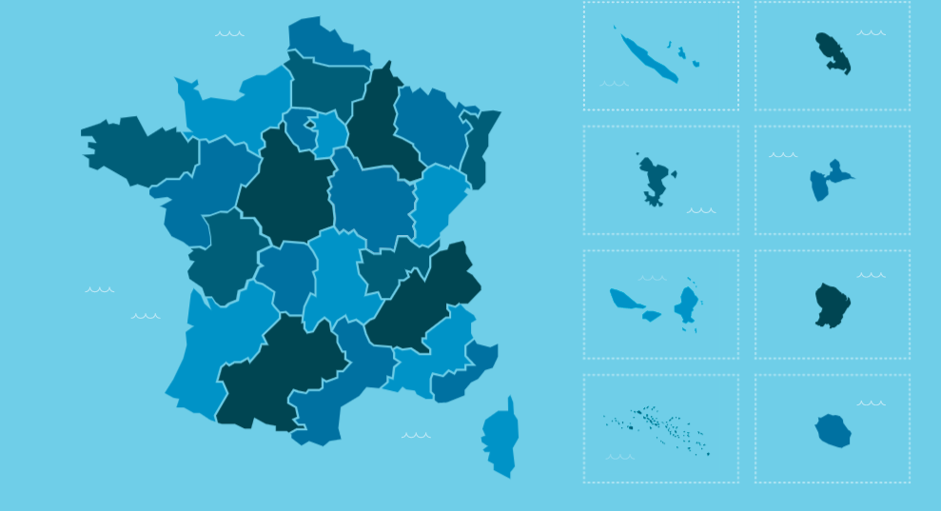
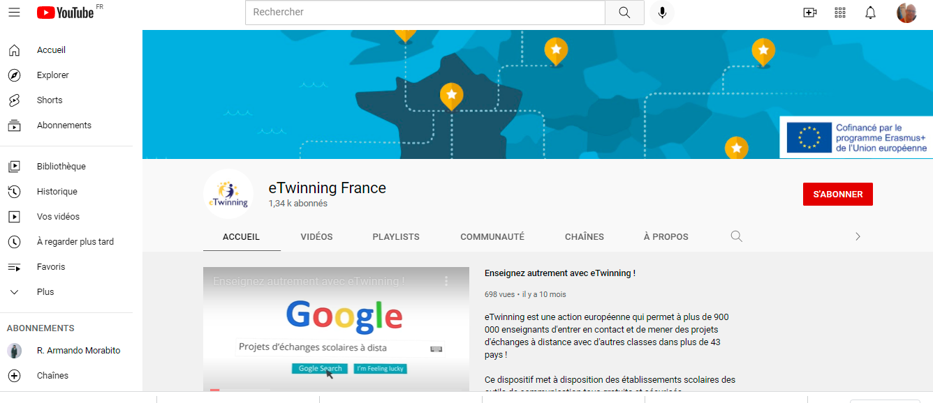
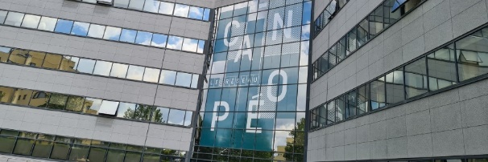
Where can I find some help ?
The regional representatives (called « CORrespondants Académiques » (CORACs)) are the main contact points in each academy,
The eTwinning France YouTube channle offers a few tutorials to help you in eTwinning, and a high number of recordings of online trainings.
The National Support Organisation (called « BAN » Bureau d’assistance national) can be reached by sending an email to contact@etwinning.fr ou assistance@etwinning.fr

